Slide 1
AFWA It Pays to Belong!

Slide 2
The mission of the Accounting & Financial Women’s Alliance is to enable women in all accounting and finance fields to achieve their full potential and to contribute to their profession. Connect.Advance.Lead™
Founded in 1938

Slide 3
To Be The Premier Organization For All Accounting and Finance Fields
Our Vision…

Slide 4
What do I get for my due's dollars?
Low-Cost High-Quality CPE and 12 Free CPE
Mobile App
Discounts from Partner Benefits
2 National Conferences with Discounted Member Rates
Website Dedicated to You and Your Profession with a Members Only Section
Bi-Monthly Newsletter and Other Publications
Find A Pro Listing and Access to Premium Listings
Leadership Development Opportunities – National and Local
Chapters Involvement and Activities
Career Center and Support
Scholarships
Members Only Online Discussion Boards
Networking – Connect with Industry Professionals
Dedicated Membership Support Staff
Dedicated You Tube Channel
Continuous Communication through Social Media, Internal Communications, etc.
And much more…

Slide 5
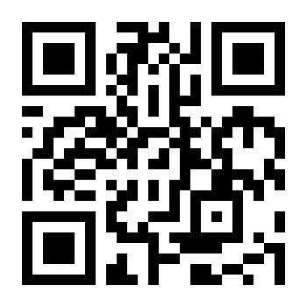
App (in Google play or App store) Access to website on the go Communities (coming soon) Network of peers Conferences CAL - June 15th & 16th – Virtual Silent Auction WWC October 25th – 27th – Reno Signature Event

Slide 6
Getting the Most Out of Membership
Volunteer Today
There are a variety of opportunities available to fit your time and availability
Scan this QR code and
VOLUNTEER TODAY!

Slide 7
AFWA offers members a unique career center with specific jobs in the accounting and finance industry.
Plus take advantage of our free resume review offered at
https://jobs.afwa.org/

Slide 8
AFWA Membership Campaign
Sign up 3 members and get $100 amazon gift card
Use the code NEWMEM25 to receive a $25 discount on membership
Corporate Discount Codes available - Click Here for a List

Slide 9
Member Appreciation Month - May
Membership Appreciation Month - Accounting and Financial Women's Alliance (afwa.org)
Celebrating those that make our organization strong and letting you know that You Count!

Slide 10
Membership Renewal
Invoices ready - Today – June 30 Log into the member portal
Make sure we have an alternate email for you on file
Chapter Forms Due – May 15
https://forms.office.com/r/nEnLBzzcFr

Slide 11
Questions?
How can we help you get the most out of your membership?
Thank you for all you do and for being a member of AFWA!

