Slide 1
Chapter Training: Submitting CPE
For Fast Approval

Slide 2
CPE Timeline
CPE Packets are due to AFWA Headquarters within 30 days of your program!
All requests for the current year are due to AFWA Headquarters by September 30!
  All CPE information for events held Nov 1, 2020 – Sept 30, 2021 must be submitted
  A CPE request form must be submitted in advance for any event planned for October 2021.
CPE Submission Deadline
include pre-approvals for October
Sept 30, 2021
Nov 1, 2020
Oct 31, 2021
NASBA Programming Year
Notes:
The 30 day requirement is consistent with NASBA Standards. However, we recommend packets be submitted as soon as possible, (1) out of respect to attendees anticipating approved CPE (2) for your own benefit to get the paperwork off your hands and prevent losing any documentation.
If your packet is not approved due to missing items, you will have until the end of the NASBA programming year to submit your completed packet – September 30. We will not approve anything outside the current year. For example, we will not approve any programs prior to November 1, 2018 – even if the packet had partially been submitted previously.
We are required to submit our list of CPE approved events to NASBA by November 1, 2019. Because of this tight turn around, we ask that your Chapter submit all CPE held November 1, 2018 – September 30, 2019 by September 30. For any events your Chapter plans to host in October 2018, please submit your CPE request form by the September 30 deadline. You may submit the remaining requirements following your event.
This September 30 deadline allows ample time for to prepare a complete report for our NASBA licensing renewal.

Slide 3

Materials
All forms and materials discussed are available in the AFWA Members Portal > Programming Toolkit
Additional CPE FAQ’s are available
NASBA Fields of Study
https://www.afwa.org/member-home/programming-toolkit/

Slide 4

Checklist & Request
CPE Request for Credit Checklist
  Your guide for preparing all the required materials
  This form does not need to be submitted with your request
Request for CPE Credit Form
  Includes all the general information about your event, must be signed by the President or CPE Chair
  Required Instructor information
  Single Program or Multi-Program forms
Notes:
NASBA’s rules… not ours!

Slide 5

Speaker Information &
CPA Participation
Speaker information, including name, title, company name and brief bio should be included on either the CPE request form OR within promotional materials.
NASBA REQUIREMENTS
The participation of at least one licensed CPA (in good standing and holding an active license or the equivalent of an “active” CPA license in a U.S. jurisdiction) is required in the development of every program in accounting and auditing. (NASBA Standard No. 5)
The participation of at least one licensed CPA, tax attorney, or IRS enrolled agent (in good standing and holding an active license or the equivalent of an “active” CPA license in a U.S. jurisdiction) is required in the development of every program in the field of study of taxes. (NASBA Standard No. 5)
As long as this requirement is met at some point during the development process, a program would be in compliance. (NASBA Standard No. 5)
The state licensure, license number, and status of license should be maintained. (NASBA S24-01)

Slide 6

Program Information
Program description and learning objectives may be submitted on the CPE Request form or within the promotional materials.
Timed Outline
  Detail the topics covered in the presentation
  Ask the speaker to provide
  50 minutes of content + 10 minutes introduction and Q&A
Required Elements of Engagement: “A group live program must include at least one element of engagement related to course content during each credit of CPE.” (Ex. Group discussion, polling questions, instructor-posed question)
    Ask your presenter to prepare a discussion question for the group
    Note the Element of Engagement with the Timed Program Outline
Session Handouts: such as PowerPoint slides, a brochure, or flyer from the presenter.
  If none are available, initial the CPE Request to confirm that no handouts were available.

Slide 7
Promotional Materials
How did you get the word out about your event?
  Screenshot of event page on website or Facebook
  Copy of email or newsletter
Template available to ensure you include all the required information:
Learning Objectives | Program Description
Delivery Method | Registration Requirements
Recommended CPE | Refund Policy
Field of Study | Complaint Resolution
Prerequisites/Preparation | NASBA Registry Statement
Required if intermediate, advanced or update.

Slide 8


Description vs Objectives
A description provides a general overview of the topic and what the presenter will discuss
Learning objectives complete the sentence “After completing this course, you will be able to…” providing key take aways for attendees.
Notes:
It’s important to note as we talk about session promotion that simply saying ‘our chapter is going to have speaker on tax next month’ is not enough to bring attendees. There is a lot of competition for CPE these days online course, as well as through employers are giving professionals more options for their education. You have to give attendees enough information that they can make an informed decision about whether or not they’ll attend your event – or even if their employer will support their attendance.
Following these NASBA promotional requirements will help you to do that.

Slide 9
NASBA Program Levels
All programs labeled as intermediate, advanced, or update must clearly identify prereq education, or experience.
Tip: use the level definition to provide the perquisite. For example: This program is most appropriate for CPAs with a detailed knowledge in Tax…
Basic - most beneficial to CPAs new to a skill or an attribute. These individuals are often at the staff or entry level in organizations.
Intermediate - builds on a basic program, most appropriate for CPAs with detailed knowledge in an area. Such persons are often at a mid-level within the organization, with operational and/or supervisory responsibilities.
Advanced - most useful for individuals with mastery of the particular topic. This level focuses on the development of in-depth knowledge, a variety of skills, or a broader range of applications. Advanced level programs are often appropriate for seasoned professionals within organizations
Overview - provides a general review of a subject area from a broad perspective.
Update - provides a general review of new developments. This level is for participants with a background in the subject area who desire to keep current.

Slide 10
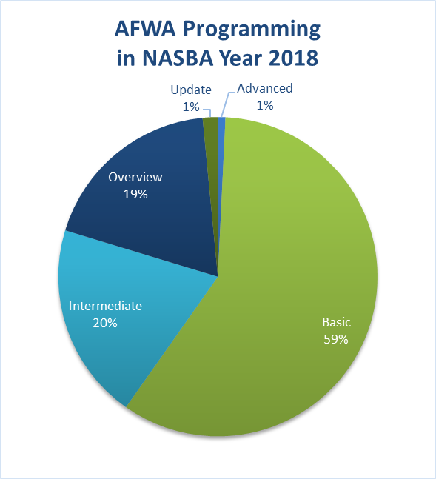
YOU’RE NOT BASIC
Basic = entry level
Attendees want to learn something new and are drawn to intermediate and advanced programming
Evaluate your programming and push higher, don’t underestimate your attendees
Set Goals!
  Host an advanced workshop and charge a registration fee
  Host more intermediate than basic

Slide 11
Attendee Sign-In
Attendee Sign-in
  All attendees must sign in
  An RSVP list does not meet the NASBA requirements
Template is available – feel free to customize
  Time in/Time out
  AFWA Member yes/no
  Email address and/or phone number
    Especially important if sending certificates electronically
  First time attendee yes/no
Responsibility to monitor attendance: … CPE program sponsors must maintain a process to monitor individual attendance at group programs to assign the correct number of CPE credits. (NASBA S16-02)
  Time in/Time out
  CPE Monitor for the full session

Slide 12

Program Evaluation
Use the template provided to ensure all the required questions are asked
Provide a summary of responses
Survey Monkey
  eSurveys may be used, however be sure you are still collecting feedback from all attendees.
  Consider providing feedback to your speaker and always review for your own planning

Slide 13

Program Evaluations
BONUS TIP: Use this opportunity to ask other questions of your attendees
  Recommendations for future program topics or locations
  Volunteer interest

Slide 14
Certificate of Completion
Single and Multi-event templates available on the Members Portal
  Your Chapter may design your own Certificate, but all NASBA required information must be included.
Does not need to be signed by the attendee, must be signed by the President or CPE Chair
May be distributed to attendees at the program or following via email
  Must be provided as soon as possible to attendees, not to exceed 60 days
Be aware of any additional State requirements
As long as a complete sign-in sheet is provided only one Certificate needs to be submitted
  Leave the attendee line blank
Notes:
Question: How does your Chapter deliver your certificates to attendees – onsite, following the event?
Why? On occasion, we will receive a call from a member who is being audited. If she is missing a certificate, we can reference the sign-in sheet, fill in her name on the certificate copy, and provide her an approved certificate of completion.

Slide 15
Most Common Send Backs
Missing Documentation
  Handouts
  Promotional Material
  Timed Outline
Wrong Field of Study

Slide 16
Zoom Events
For online group-live events, all the same materials are required to submit CPE
You can download attendee reports from Zoom to confirm every attendee was logged in for at least 50 minutes
If you’re unable to download these reports, you can list all attendees and track their start and end times
All attendees will also need to complete 2 out of 3 of the session’s polling questions

Slide 17
Retention – 5 years
List of program attendees
Date and location of program
Names of instructors or speakers
Copies of completed program evaluations
Amount of recommended CPE
Consider a Dropbox for your Chapter

Slide 18
NASBA FIELDS OF STUDY
TECHNICAL
NON-TECHNICAL
Accounting
Accounting (Governmental)
Auditing
Auditing (Governmental)
Business Law
Economics
Finance
Information Technology
Management Services
Regulatory Ethics
Specialized Knowledge
Statistics
Taxes
Behavioral Ethics
Business Management & Organization
Communications & Marketing
Computer Software & Applications
Personal Development
Personnel/Human Resources
Production

